Slide 1
Astaro Application Control Next Generation Firewall
Aleš Kotmel, Annex NET

Slide 2
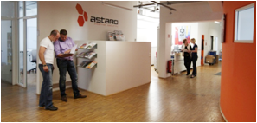
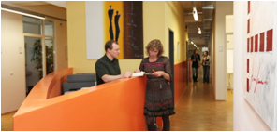
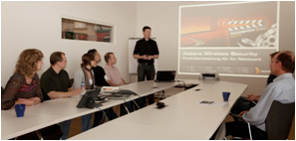
Astaro – Stručný přehled
Vůdce na evropském trhu Unified Threat Management řešení (UTM)
Rok založení: 2000
Neustálý obchodní růst od r. 2005
Aktivně rostoucí podíl na trhu
Produkty certifikované dle Common Criteria a ICSA
Držitelem více než 120 ocenění za své produkty
Design a vývoj probíha v Německu
Sloučení s firmou Sophos (05/2011)
Notes:
Astaro was established in the year 2000 with the idea to provide technology to protect users against viruses and other Internet threat.
Right from the beginning the focus and concentration was on added value in the Internet Security space. Components which had been available in the open source community had been taken. Missing pieces had been developed and finally a product was completed by user interface, documentation and support.
The success through the first decade of Astaro is based on easy of use and an undisputable protection. It simply works!
With our solution partners, mostly System Integrators and Value Added Resellers we have more than 50,000 customers around the globe and we are growing and gaining market share and relevance in our market right now.
Astaro is perceived as a major driver from the firewall to the UTM technology. What was called in the beginning a “all in one” approach turned into Unified Threat Management (UTM). Don´t be surprised to hear more from Astaro the term “Astaro Security Wall” which is the next innovation step we will make. Based on the concept “Astaro Security Wall” we will give companies guidance and technologies to be protected in all aspects of IT. For our integration partners it means incremental business opportunities in regards of technology and consulting services.
Our desire will remain to invent future proven technology. At the moment we are working on layer 7 technology, on Log management, on client security, on multiple feature request from our customers and partners.

Slide 3
Internetové hrozby na vzestupu
Crackers Botnets Spam Phishing Scam Hoax Viruses Spyware Gray ware Intrusions Denial of Service Distributed Denial of Service Ping floods Eavesdropper Script Kiddies Espionage Malware Root kits Adware P2P File sharing Trojans Spit Bots Backdoors Buffer Overflows Hackers Malcode Bugs Key loggers Crime ware Pharming Competitors Identity theft Exploits DNS poisoning Snarf attacks Spam bots Spy bots Trap doors War driving Ransomware ASCII bombs Bluesnarfing Worms Decrypting Reverse engineering Phreaking Port Scanning
Notes:
The different threat scenarios for a company's IT infrastructure has heavily evolved over the past 10 years, to the point where new technology updates are constantly required for sufficient protection. This is partly due to the continuous increase in complexity of the IT landscape. The threats themselves are also rapidly evolving and can often only be fought through a combination of different technologies.

Slide 4
Moderní výzvy v oblasti IT bezpečnosti
Náklady
Časová náročnost
Router
Firewall
IPS
SSL VPN Gateway
E-Mail/Spam Filter
GW Antivirus Filter
Web Filter
WAN Link Balancer
Load Balancer
Celkem:
Notes:
The number and complexity of the tools, which are required for IT security, is also on the rise. Firewalls and VPN gateways no longer provide sufficient protection. The use of Intrusion Detection and Prevention Systems (IPS) has become a mandatory asset and the demand for tools which check e-mails and web downloads for dangerous content such as spam, viruses, spyware, phishing is also on the rise.
With every additional tool employed in your IT security infrastructure, the costs, expenditure of time for installation, training and maintenece will also increase.
As as result, many company's today cannot cover this requirement.

Slide 5
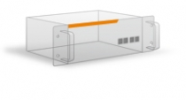
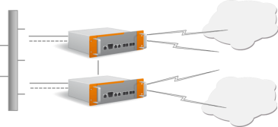
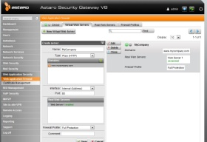
Astaro – přístup „vše v jednom“
Flexibilní nasazení
Softwarová Appliance
Virtuální Appliance
Integrace kompletní e-mailové, webové a síťové bezpečnosti
VPN & Wireless
Prvky
All-In-One Appliance
Síťové funkce pro vysokou dostupnost a
rozkládání zátěže
Unifikovaný management
všech funkcí dostupný
z prohlížeče
Centralizovaný
Management & Reporting
Notes:
Though the Astaro Security Gateway (ASG) family, we are able to provide an integrated complete solution for e-mail, web and network security.
The browser-based management interface allows for easy configuration of all functions with just a few mouse-clicks - also without vast knowledge of technical IT know-how.
The Astaro Command Center enables a central establishment and overview for larger and more wide-spread installations of up to hundreds of Astaro Security Gateways.
Networking features such as high-availability (HA), clustering, server and WAN link balancing provide constant reliability and scalability for your deployment, usually available only to enterprise solutions.
The Gateways are supported by tools which help extend your functionality for smooth daily business operations:
Astaro RED offers complete and centrally administered UTM security for remote offices and can be configured in minutes - without the need of local IT personnel.
With Astaro Wireless Security, you are able to easily connect our Access Point devices with your ASG's security features.
Astaro VPN Clients provide mobile employees with secure and easy to administer remote access to the corporate network.
The Astaro Smart Installer is a bootable USB device, with which you are able to easily install the latest version of Astaro Security Gateway software.
ASG provides the same functions on all appliance models: hardware, software and virtual, allowing for more flexible deployment scenarios.

Slide 6
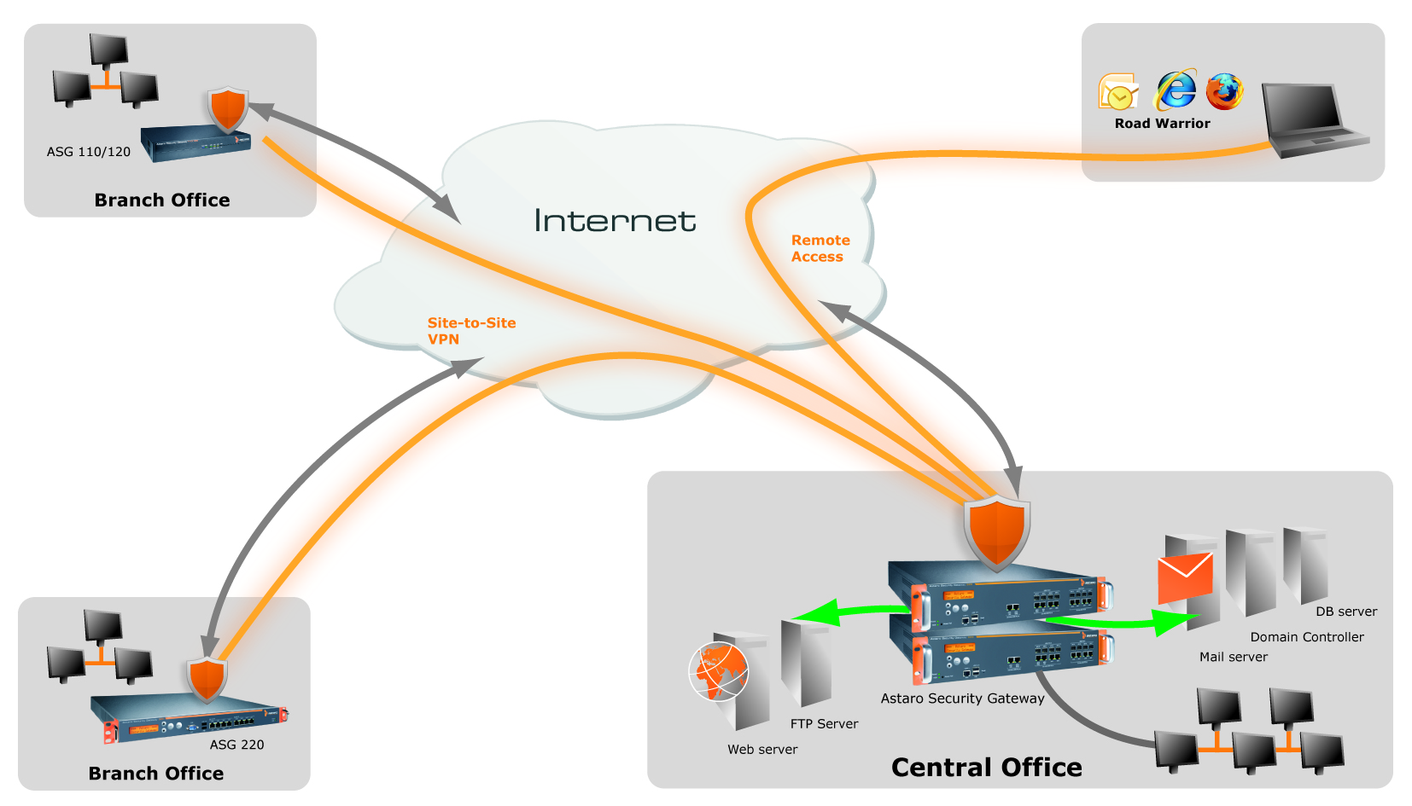
Možnosti nasazení
Notes:
This slide illustrates different deployment scenario possibilities for Astaro Security Gateway.

Slide 7
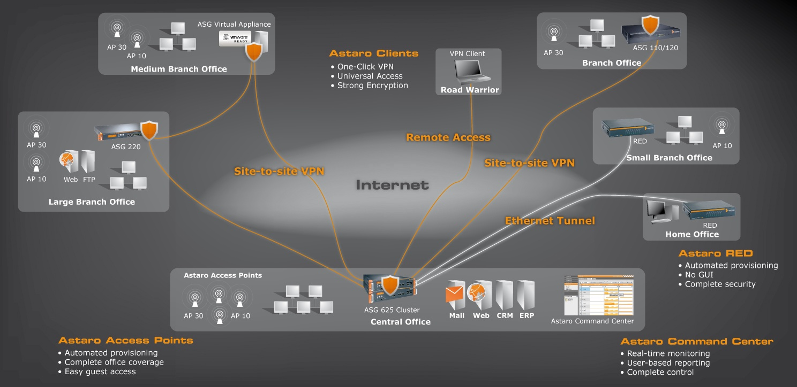
Astaro Produkty
Notes:
Astaro‘s goal is to provide complete IT security solutions which integrate the right technology and are also understandable, easy to use and pragmatic to employ. Furthermore, the solutions should be independent from the platform.
Through the Astaro Security Gateway product family, you are able to establish a central component for the protection of Internet traffic as a whole. The solution can be adopted as self-managed solution, a managed Gateway solution for the customer (CPE) or as cloud-based service available through service providers or partners.
Astaro Mail Archiving is a hosted service which simplifies mailbox management and legal compliance requirements.
The image in the slide above illustrates the possible deployment scenarios for Astaro products.

Slide 8
Bezpečnostní funkce
Wireless
Security
Network
Security
Wireless Controller for Astaro Access Points
Multi-Zone (SSID) support
Essential
Firewall
Intrusion Prevention
IPSec/SSL VPN
Branch Office Security
Stateful Firewall
Network Address Translation
PPTP/L2TP Remote Access
optional
optional
optional
optional
Web Application
Security
Web
Security
Reverse Proxy
Web Application Firewall
Antivirus
optional
URL Filter
Antivirus & Antispyware
Application Control
Mail
Security
Anti Spam & Phishing
Dual Virus Protection
E-Mail Encryption
Bezpečnost třídy Enterprise-class pro SMB
Notes:
For every Astaro Security Gateway, a free Essential Firewall license is available. This license provides the base functionality with fundamental security features activated for the protection of company networks. This basis can also be flexibly extended through optional subscriptions for Astaro Network, Web, Mail, Web Application and Wireless Security. You can also add an option for the Log Management service.
Many providers of UTM solutions list in their datasheets a large number of functions. Often enough however, certain product features are only rudimentarily implemented. For example, some manufacturers talk about spam protection when they only employ a single mechanism such as RBL lists. Effective spam protection is only reached however through a combination of different techniques, which are specialized in recognizing certain spam methodology. Enterprise e-mail solutions and Astaro's UTM solutions work in this way.

Slide 9
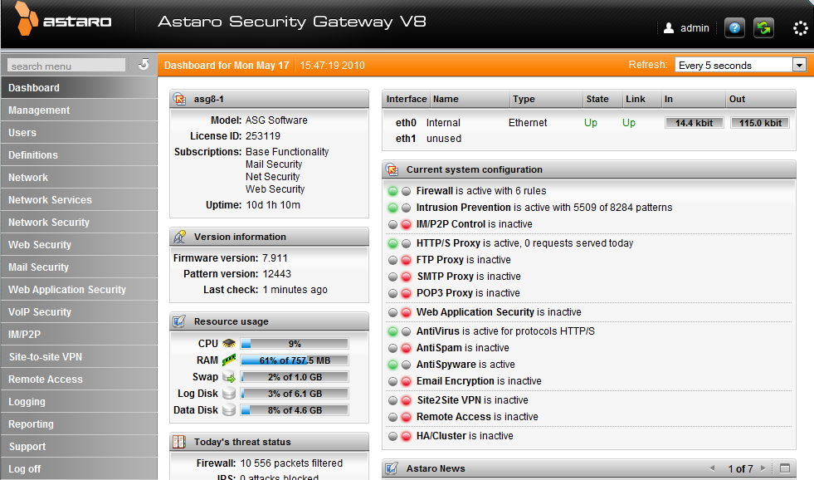
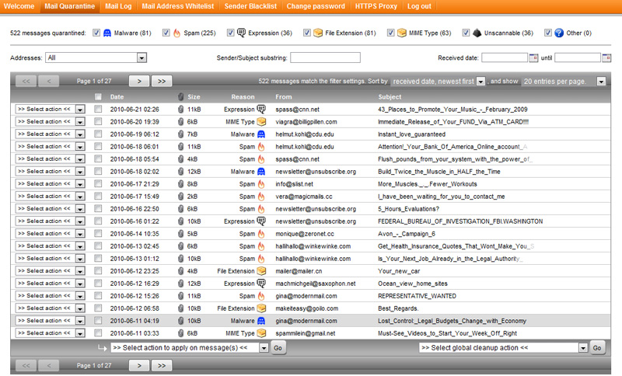
Jednoduchý management
Intuitivní Dashboard
Individuální uživatelský portál
Rozsáhlé reportovací možnosti
Notes:
Simple management is one of the most important aspects for an all-in-one security solution.
Esepcially designed for the requirements of small and middle sized companies, all features can be easily used without much technical security know-how. For this reason, every function can be configured via an intuitive browser-based user interface in many different languages.
The intuitive dashboard provides a quick overview about the current status of the Gateway, for example the resources used, active connections and recognized malware.
The UserPortal allows every user to see their individual mail log, manage their own spam quarantine or install their own VPN Client configuration with a single mouse click. This saves the administrator much time.
Extensive log data, which is stored in a local database, allows the generation of many easy to read reports.
Especially in their own user friendliness, many of today's UTM solutions come up short.

Slide 10
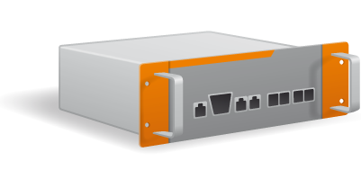
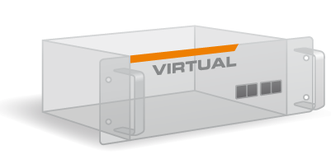
Možnosti nasazení
Hardware Appliance
Software Appliance
Virtual Appliance
Application
Aplikace
Operating
System
Operační
systém
Hardware
Hardware
První UTM Appliance, která splnila podmínky
certifikace pro VMware READY
Notes:
There are 3 deployment options for all of Astaro’s appliances
Software Appliance
Since the operating system and all featured applications are bundled within a single ISO image, Astaro software appliances are much easier and faster to install than software applications that require a separate, pre-installed operating system.
By supporting a broad range of Intel-compatible server systems, software appliances allow for maximum deployment flexibility on your hardware of choice.
The Astaro software appliances are available on CD with a printed manual or can be downloaded directly from Astaro servers and independently burned onto a CD. There is no need for client based software installation. Specific licensing packages are available, varying by the number of users/IP addresses.
Hardware Appliance
Astaro hardware appliances are based on high quality Intel-compatible server systems with each model offering an identical feature set. Small businesses do not have to surrender important security features due to scaled-down hardware performance. All models offer an integrated hard disk drive in order to locally store quarantined emails and log data, avoiding the need for additional servers.
Astaro hardware appliances can be easily deployed at the perimeter of your network to protect all email, web and network user traffic. Since all hardware appliances feature a pre-installed operating system and software, the initial setup will be fast and without complication. There is no further need for client based software installation.
With a complete range of models available, Astaro hardware appliances effectively protect networks from 10 to more than 2000 users.
Virtual Appliance
Astaro virtual appliances allow for easy deployment in virtualized environments. Optimized hardware allocation and reduced hardware expenditure is available since physical computers are able to run multiple virtual servers/appliances in parallel by using the underlying virtualization infrastructure. As a result, it is ideally suited for both managed security services as well as companies of all sizes consolidating physical servers onto fewer virtual systems.
The Astaro virtual appliances can be downloaded from Astaro servers and burned independently onto a CD. It can then be installed on any VMware system running either a VMware server or VMware ESX server. Specific licensing packages are available, varying by the number of users/IP addresses.
Astaro is one of the few security vendors offering a virtual appliance and we have been partners with VMware for over 5 years.
Astaro’s Software Appliance also supports Citrix Xen, KVM and Microsoft Hyper-V virtual environments
10

Slide 11
Astaro Security Gateway Products
Hardware Appliance | 110/120 | 220 | 320 | 425 | 525 | 625
Environment | Small networks | Medium networks | Medium networks | Large networks | Large networks | Large networks
Network Ports | 4 | 8 | 8 | 6 & 2 SFP | 10 & 4 SFP | 10 & 8 SFP
Max. recommended FW Users | 10/50 | 150 | 350 | 1000 | 2500 | 4000
Max. recommended UTM Users | 10/25 | 70 | 200 | 600 | 1300 | 2000
Software Appliance * | Runs on Intel-compatible PCs and servers
Virtual Appliance * | Runs in any VMWare environment
*Pricing based #IPs/Users
Notes:
The ASG product line covers models for small networks and remote locations with up to 10 users to large networks with up to 5000 users.
As opposed to other UTM solutions, Astaro software can be also installed on your own servers.
The same set of security applications, including features such as Active/Active Clustering, WAN Uplink Balancing or Active Directory Integration, is available on all Astaro Security Gateway models - no matter if the hardware, software or virtual appliance is deployed.
Furthermore, every hardware appliance contains an integrated hard drive for local spam quarantine and log/reporting information. Therefore, even the smallest remote office can get the same protection as a company's central office - without compromise.
The ASG 525 and 625 models offer the highest availability through a redundant hard drive and power supply.

Slide 12
Stateful firewall, Proxy server a Next Generation Firewall
Stateful packet inspection (SPI)
VPN Gateway a VPN Remote Access
Routing a Switching
NAT
IDS/IPS
Stateful firewall
Content-filtering web proxy pro HTTP/HTTPS Caching
Aplikační proxy: DNS, SMTP, POP3, IMAP, FTP
Řízení / blokování P2P a IM
Proxy server
Detekce aplikací
Allow/block aplikací dle uživatelů
Allow/block aplikací a jejich subfunkcí
Allow/block aplikací dle typu, tagu, risk ratingu a kategorie
Next Generation Firewall

Slide 13
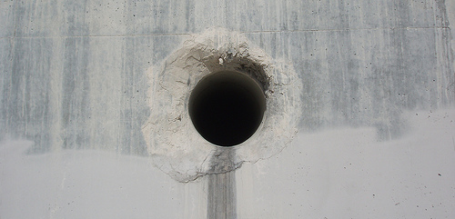
Jak dnes řídíte webové aplikace?
?
?
V betonu ten problém není!
Notes:
-Think of your firewall/web filter as a concrete wall.
-You want to allow water to pass through it, so you drill a hole for it. However, once the hole is drilled, you can’t know if the hole is being used as you intended unless you stand there and watch the activity closely, otherwise poison could use the hole as well as the water and you wouldn’t even know.
-Web applications present the same problem to your firewall.
-They are sneaky, and now use common holes (like ones opened by the administrator for you to surf) in order to function uninhibited.
Just like our concrete wall, if we want to know more about what is passing through our firewall and filters, we must add some capability to our infrastructure.
The problem is how to separate the desired or “good” traffic from the unwanted or dangerous. Admins need a way to see what is going on, and make decisions based on what they want to allow or block.
-Application Visibility and Control COMPLEMENTS your firewall and other existing tools by increasing your security with new capabilities.

Slide 14
Vaši uživatelé používají nevhodné aplikace!?
Co uživatelé dělají?
Proč je Internet pomalý?
Jaký to má dopad na společnost?
Notes:
-Here is the problem: Employees need the Internet to do their jobs, but web applications can kill their productivity and damage your infrastructure.
-Encrypted, sneaky applications like Ultrasurf allow users to bypass your security and surf unfiltered and bypass Intrusion Protection and Virus Scanning.
-Even worse, remote control applications like Go2MyPC and TeamViewer allow unauthorized people to enter the company network from the outside!
-File sharing applications can leave the company liable for illegal downloads done by their employees, and limit the Internet speeds of others trying to work.
-88% of Facebook usage at work is simple profile and news viewing, companies DON’T have a “Farmville problem”.
Applications are now developed specifically to work through existing firewalls and Web Filters.
To keep your business secure, you need to identify and control applications. For this, a different capability is needed.
OLD Notes:
-But think about how much time and bandwidth is lost to real habitual behavior like just going through the morning news and watching a few dozen video clips. Then it’s time to review the Facebook recent events, even if there are hundreds of them. They have the links to click, the videos to watch, the responses to write, all while they should be working! Ask yourself, do you REALLY know how employees spend their day online? Would you like to? Is your company going to be liable for what they download? Will they get something which bypasses your protections, infects them, and promptly attacks everything on the network? These are questions you should be asking.

Slide 15
Astaro pro vás má řešení!
Budete:
Vidět
Ovládat
Řídit
Referovat
Notes:
-The ability to identify traffic and control what happens in the network is a powerful tool which appeals to customers and is driving sales decisions.
-Existing solutions are focused on the building and maintenance of “rules” which can control what is allowed to happen.
-This style of network security management has remained mostly unchanged for over 20 years; admins will create policy which they HOPE will stop unwanted or dangerous traffic.
-Astaro’s approach is to focus on the visibility and work with you from there.
-Admins should:
See what is happening in real-time
Be able to completely block or allow applications
Allocate bandwidth and prioritize by shaping traffic to their requirements
Review and report on what happened in the past
-With the right information presented correctly, they are in a better position to evaluate where they are, and where they want to go. After all, like a maze, navigating blindly and making guesses won’t be the best route!
Let’s look at why our solution is different from the competition by focusing on the SMB and their needs without all the complex training and administrative overhead…

Slide 16
Application Control (NGFW) - Flow Monitor
Sledování provozu v reálném čase
Interaktivní přehled ve formě grafu nebo tabulky
Jednoduše zjistíte, co se děje ve vaší síti
Získáte informace o využití šířky pásma, uživatelích a mnohem víc...

Slide 17
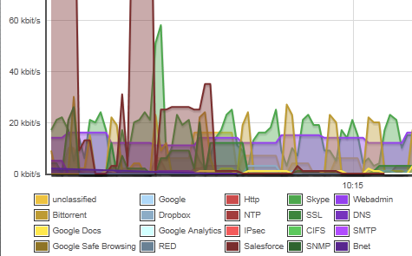
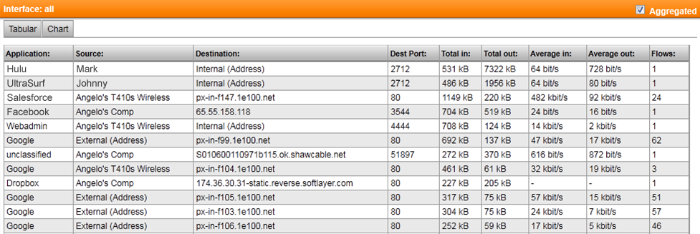
Flow Monitoring
Vidíte vše co se děje
Notes:
-The visibility is where we start, and it is crucial.
-Other solutions give you the ability to create policy and rules, but are focused on a pro-active approach. With them, you must put in place your rules from scratch.
-It is easier to get started by REACTING.
-You see what’s happening in real-time, and use the information to make EDUCATED decisions.
-With this design, you avoid wasting time on making rules which aren’t needed or a problem for your business.
-Instead of trying to do “best-practices” cookie-cutter profiles, you can specifically tailor your policy so it precisely fits your network and your usage.
-With our new flow monitor, we condense a large amount of information into a crisp, readable display.
-Like other areas of ASG, you can demand more details and drill deeper; we avoid swamping you with every number we can think you might need all at once.
-Graphical views via a live chart gives you a visual display of the traffic as it happens for an alternate way of seeing things.
The Flow Monitor will allow you to take action DIRECTLY from the display, letting you block, shape, or momentarily kill a traffic flow to give you a breather while you make adjustments or go talk to someone.

Slide 18
Application Control (NGFW) - Flow Monitor
Pro získání detailů stačí jen klinout (drill-down)
Vytvořte blokovací pravidla, nebo určete aplikacím šířku pásma kliknutím na akční tlačítka

Slide 19
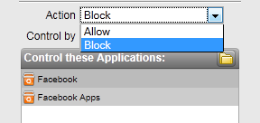
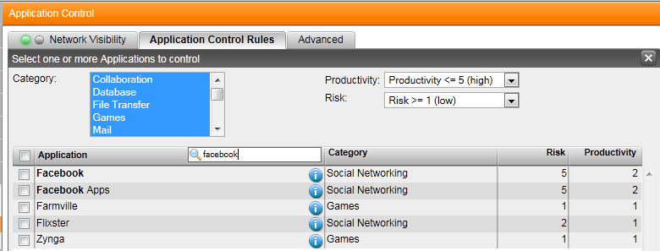
Application Control (NGFW) - Pravidla
Můžete kontrolovat a řídit stovky aplikací v Internetu
Přesně definujte pravidla používání Internetu
Notes:
-Working with the application system is possible at anytime. Using the Application Control mechanics, you are the architect of how you want your network traffic to ebb and flow.
-You can choose to block or allow individual applications which are identified regardless of their port or protocol via finely crafted recognition patterns.
-You will find applications grouped by category and labeled with Meta tags like productivity or bandwidth-usage, all of which can be used in your controlling plans.
-Choose to block all “risky” applications, or ones used for transferring files for example.
-A great design presents all this information in a concise way which can be worked with easily. Admins won’t feel overwhelmed with a slew of unknown controls and options.
-The entire layout is designed to be familiar immediately.

Slide 20
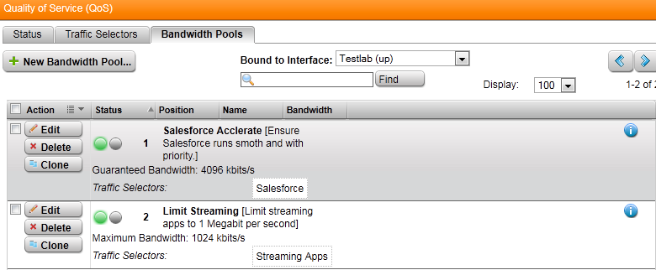
Application Control (NGFW) – řízení šířky pásma aplikací
Vytvořte přesné selektory pro šířku pásma pro důležité aplikace
Prioritizujte důležitý provoz
Notes:
-It isn’t just about blocking or allowing. Limiting admins to that kind of choice can cause more work than it saves in many cases.
-What if Hulu is needed to view webcasts or some business-related information?
-What if you need to allow salesforce.com, but also want it to have a reserved amount of your Internet connection available at all times?
-Being able to shape/tune the usage of your Internet connection is a powerful ability.
-Delivering this functionality in a useful manner gives admins something they always appreciate: choice.
-They can CHOOSE how they want activities to happen on their network, without being FORCED into a YES or NO decision which might not fit their network needs, and makes them create a ton of exceptions and place band-aids on parts of their configuration to compensate.

Slide 21
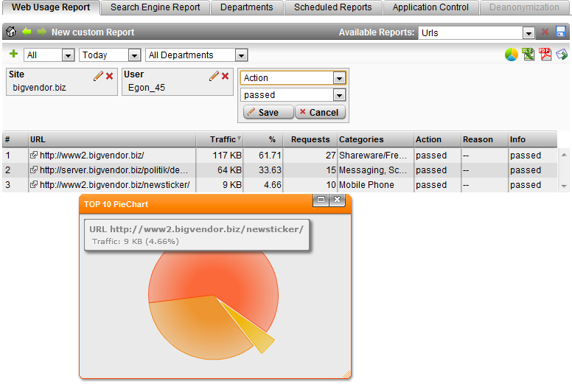
Nové nástroje pro Web-Security reporting
Interaktivní reporting engine
Snadno vytvářené filtry pouze kliknutím
Craft & Mold reporty
Žádné slepé uličky
Tisíce kombinací

Slide 22
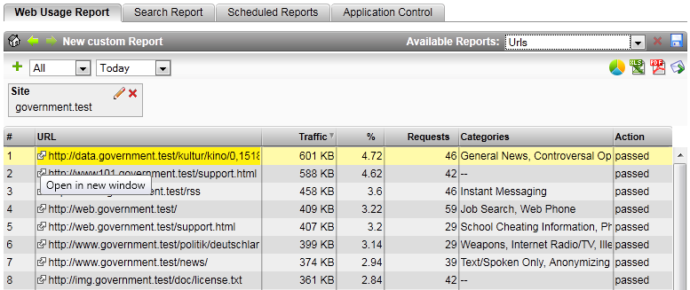
Nové nástroje pro Web-Security reporting
Audit až do úrovně jednotlivých specifických URL
Okamžitá možnost otevření odkazu v novém okně

Slide 23
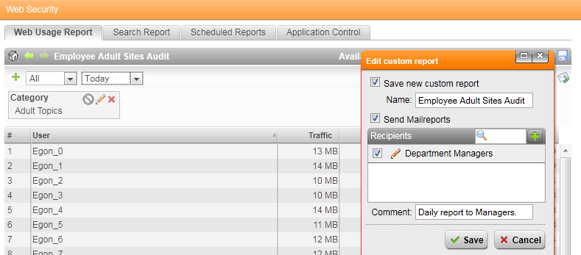
Nové nástroje pro Web-Security reporting
Vzory reportů lze uložit pro příští použití
Reporty lze okamžitě odeslat mailem, nebo lze nastavit seznamy adres pro automatické pravidelné generování a rozesílání

Slide 24
Cena a licencování
“Nechceme SMB zákazníky.”
– Nir Zuk, CTO paloalto Networks
Astaro Aplication Control (NGFW) je součástí Web Security Subscription
Notes:
-Application control out there today isn’t very affordable
-Many of our competitors sell application visibility & control as separate subscriptions or entire, stand alone-only appliances, increasing the cost, especially to the SMB
-For bigger installations, products like paloalto easily escalate to over $50,000.
-For our target market, we will match or exceed our competition in offering NGFW in features and price!
-With the majority of our customers, they will look to control traffic and applications which are web-based.
-Well, since we’re in the business of building things people WANT to buy, we’ve decided to include all this great functionality as PART of Web Security.
-Existing customers with WebSec get it FREE, and those without it can get it for a great price. Even our biggest (625) customers only pay $11,000/year.

Slide 25
Otázky a odpovědi

